Slide 1
Edge Smart Collar
ANDREW BLUM ANNA GOODMAN STEVEN BAUM ERIC QUACH GARRETT FIDALGO

Slide 2
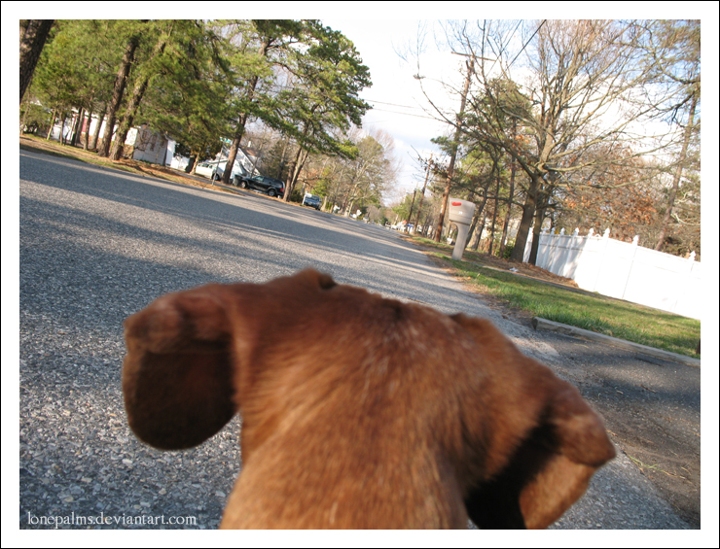
Overview
- Smart dog collar
- Includes:
GPS, camera, cellular antenna, activity monitor, shock collar

Slide 3
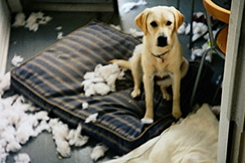
Problems
- Training pet while away from home
- Keeping track of pets activities
- Interacting with pet while away

Slide 4
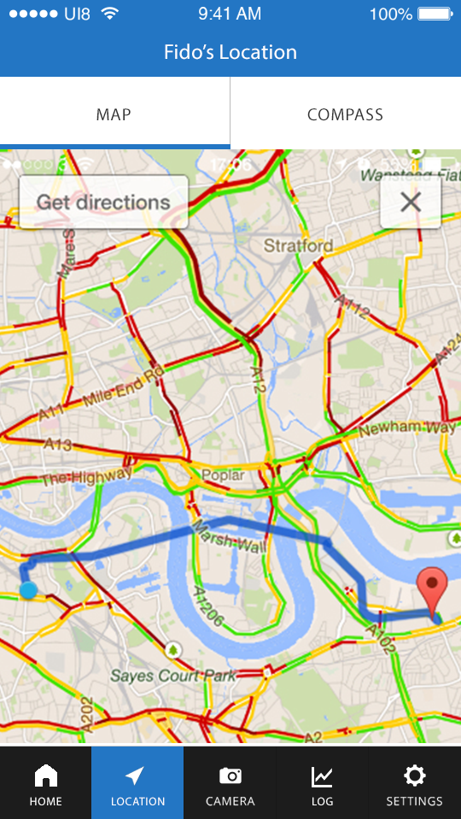
Locating your pet
https://vimeo.com/124900000

Slide 5
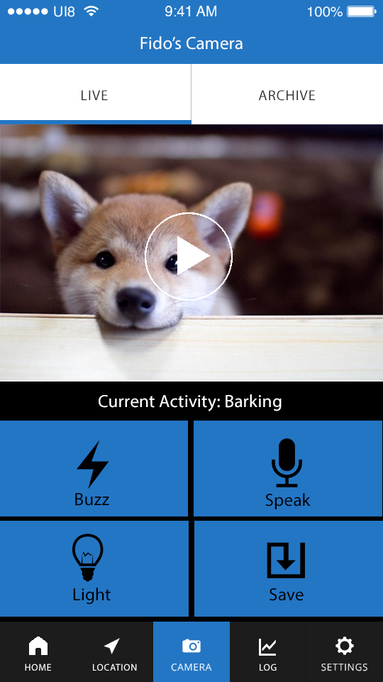
Seeing what your pet is up to
https://vimeo.com/124900002

Slide 6

Training your pet -- at work!
https://vimeo.com/124900003

Slide 7
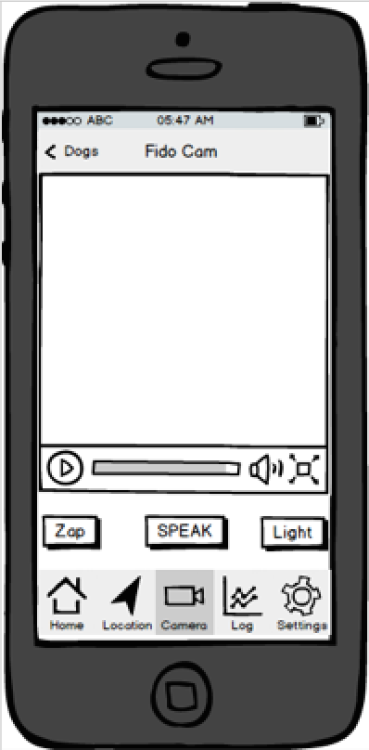
UI Changes
Larger buttons, icons
Less complicated video feed
Zap harder to hit accidentally

Slide 8
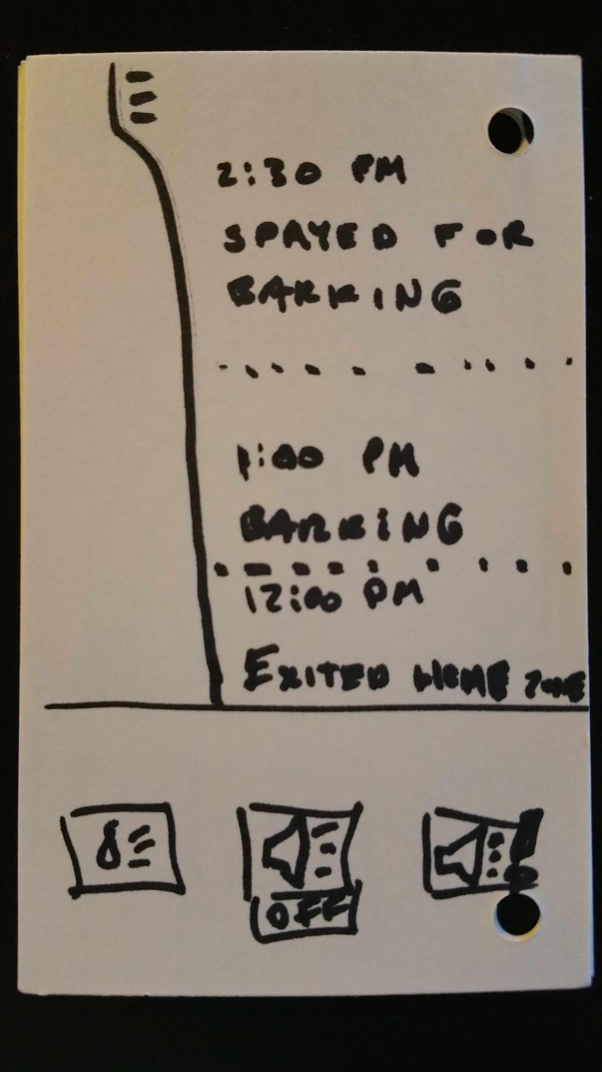
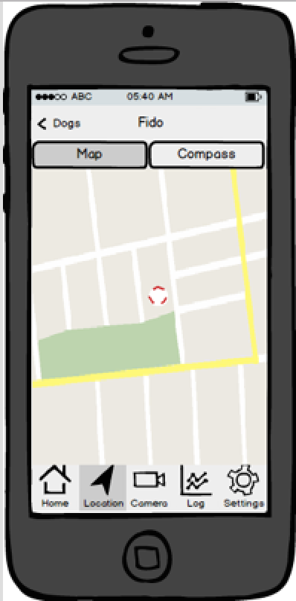
UI Changes
Changed to Google Maps
Humble beginnings

Slide 9
Summary
The Edge will allow owners to take their relationship with their dogs and continue that relationship when not physically with the dog (specifically by locating them and interacting with them remotely). This will lead to happier dogs, happier owners, and a better world.

